Slide 1
Queues

Slide 2
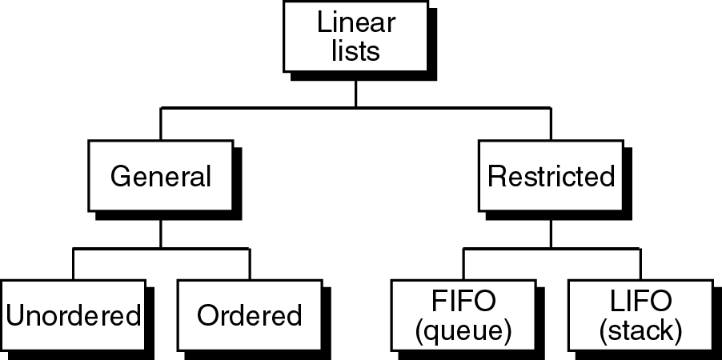
Linear Lists
Operations are;
Insertion
Deletion
Retrieval
Traversal (exception for restristed lists).

Slide 3
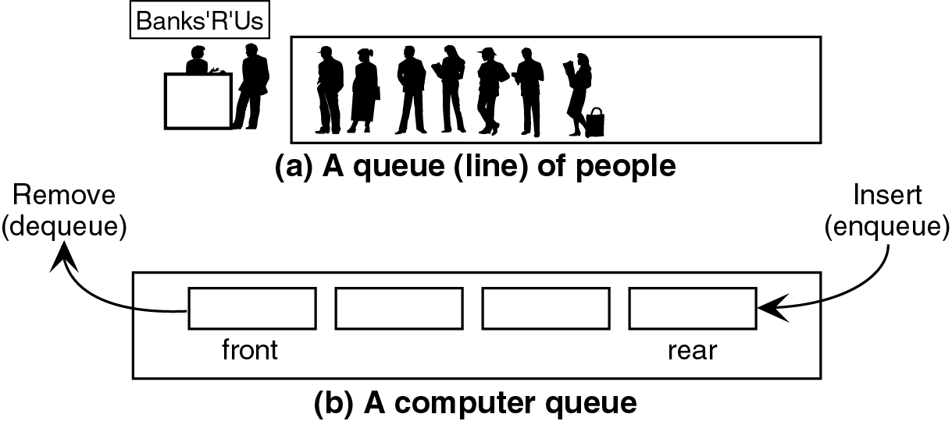
Queue
A queue is a linear list. Data can be inserted at one end (rear) and
deleted from the other end (front).
First In First Out - FIFO
Figure 1

Slide 4
Queue Operations
There are four basic queue operations.
Data can be inserted at the rear and processed from the front.
Enqueue ; inserts an element at the rear of the queue.
Dequeue ; deletes an element at the front of the queue.
Queue Front; examines the element at the front of the queue.
Queue Rear; examines the element at the rear of the queue.

Slide 5
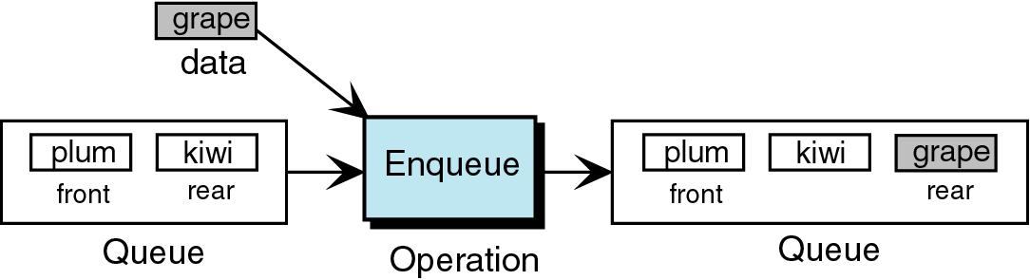
Queue Operations
Figure 2

Slide 6
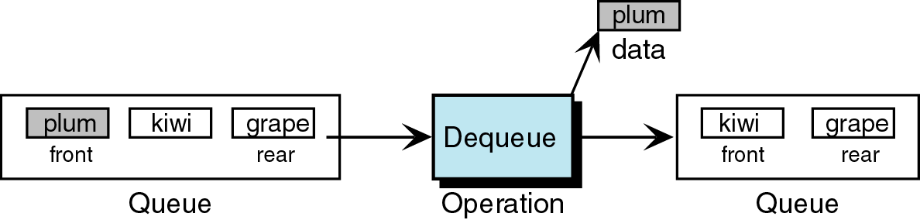
Queue Operations
Figure 3

Slide 7
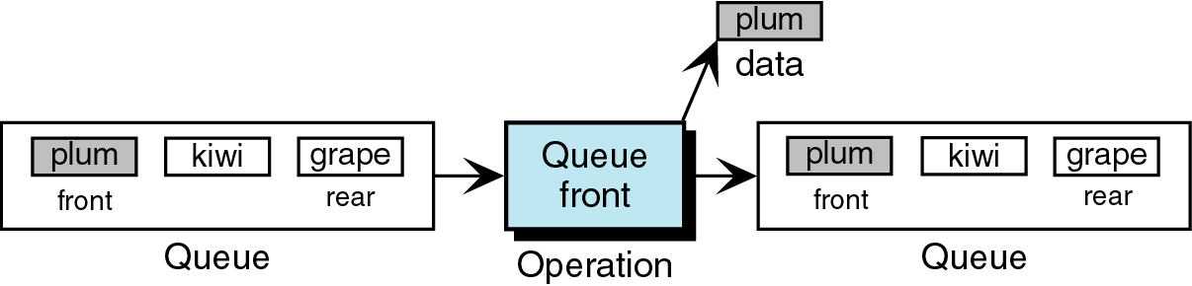
Queue Operations
If there are no data in the queue, then the queue is in an underflow
state.
Figure 4

Slide 8
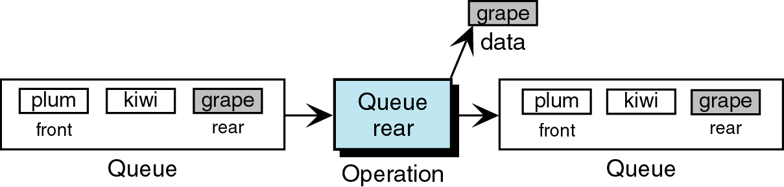
Queue Operations
If there are no data in the queue, then the queue is in an underflow
state.
Figure 5

Slide 9
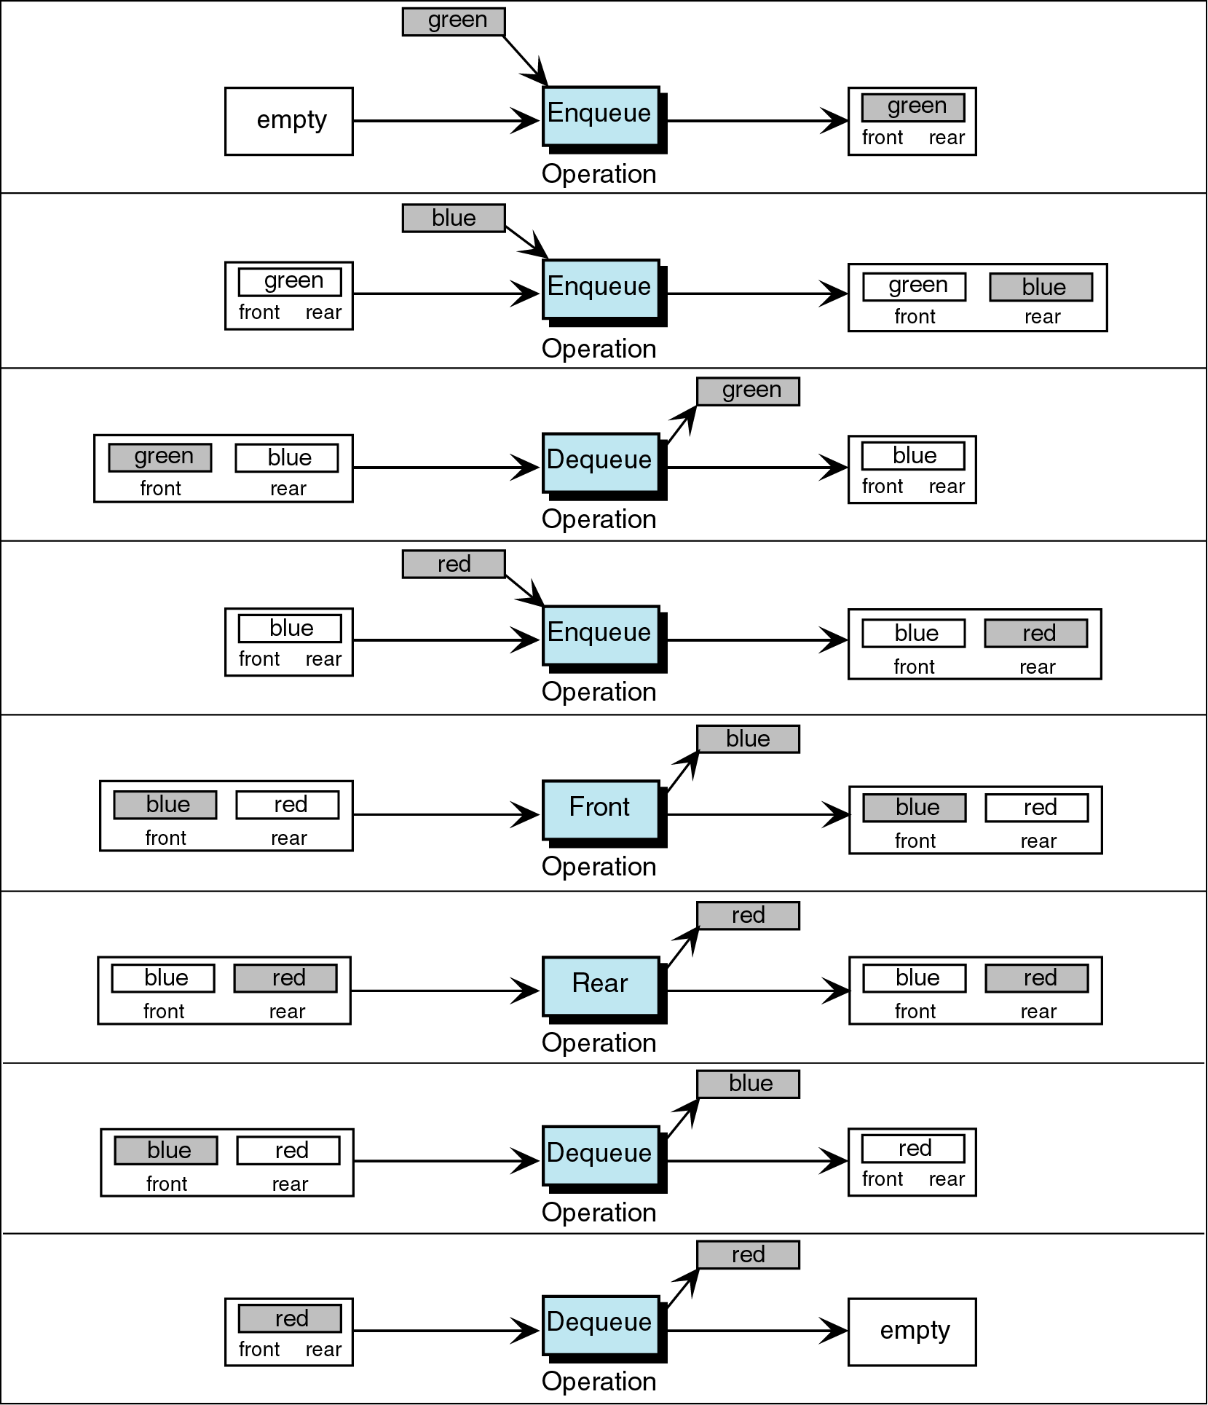
Figure 5-6

Slide 10
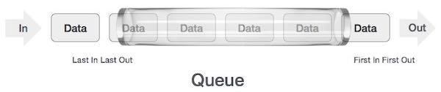
Queue Representation
As in stacks, a queue can also be implemented using Arrays, Linked-lists, Pointers and Structures.
‹#›
Lecture #00: © DSamanta
Notes:
‹#›

Slide 11
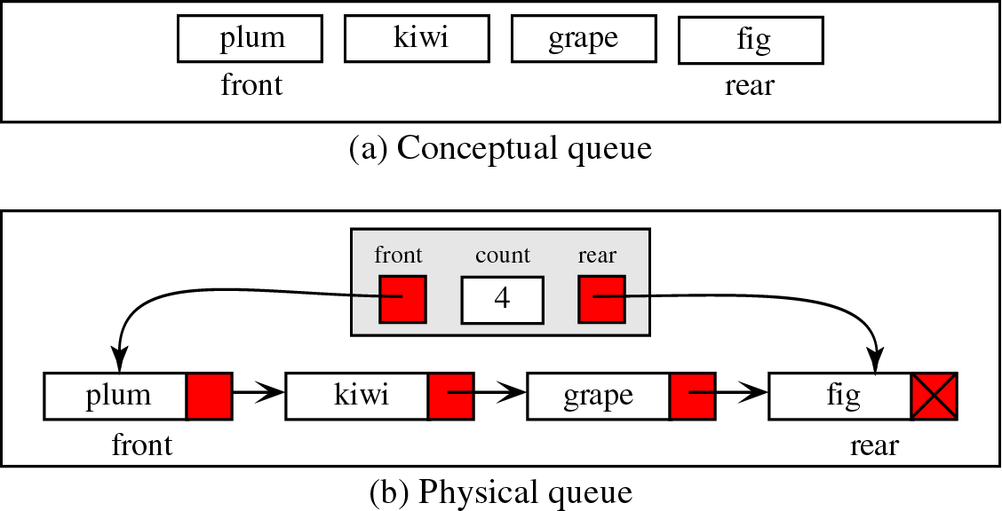
Queue Linked List Design
Figure 6

Slide 12
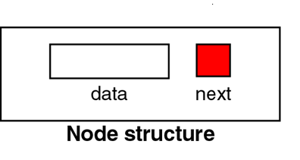
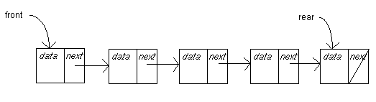
Queue Data Structure
struct node *front,*rear;
Figure 7

Slide 13
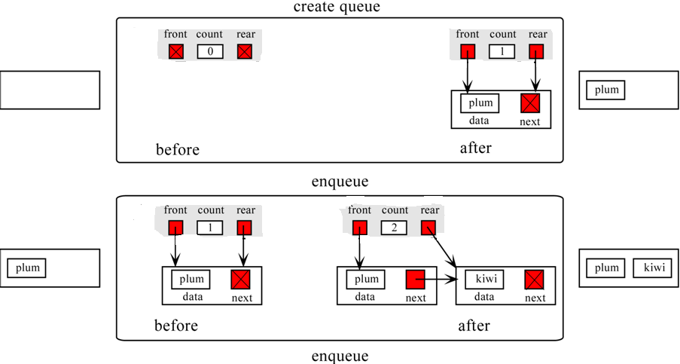

Slide 14
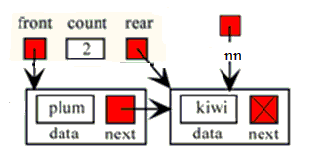
Queue Algorithms - Create Queue
void enqueue(void) { struct node *nn; nn=(struct node *)malloc(sizeof(struct node)); printf("enter a data:\n"); scanf("%d",&nn->data); nn->next=NULL; if(rear==NULL) { front=rear=nn } else {
rear->next=nn; rear=nn; } printf("%d is successfully inserted\n",nn->data); }

Slide 15
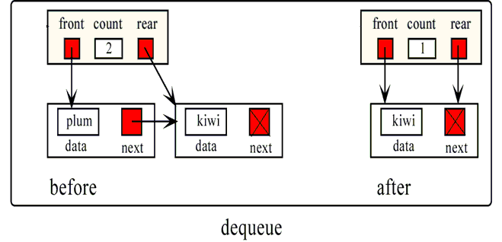

Slide 16
Queue Algorithms - Dequeue
void dequeue(void) { struct node *temp; int x; if(front==NULL) { printf("queue is empty\n"); return; } temp=front; x=temp->data; if(front==rear) { front=rear=NULL; } else { front=front->next; } free(temp); printf("%d is succ. deleted\n",x); return; }

Slide 17
Array Implementation
A queue can be implemented with an array, as shown here. For example, this queue contains the integers 4 (at the front), 8 and 6 (at the rear).
[ 0 ]
[1]
[ 2 ]
[ 3 ]
[ 4 ]
[ 5 ]
. . .
4
8
6
An array of integers to implement a queue of integers
We don't care what's in
this part of the array.
Notes:
Just like our stack implementation in the previous chapter, one way to implement a queue is to store the elements in an array.

Slide 18
Array Implementation
The easiest implementation also keeps track of the number of items in the queue and the index of the first element (at the front of the queue), the last element (at the rear).
3
size
0
first
2
last
[ 0 ]
[1]
[ 2 ]
[ 3 ]
[ 4 ]
[ 5 ]
. . .
4
8
6
Notes:
The easiest implementation also keeps track of three numbers. The size could be as small as zero or as large as the number of items in the array. The index of the front element is stored in the first member variable. The front item in the queue is at that index of the array. The next item is after the first one and so on until the rear of the queue that occurs at the index stored in a member variable called last.

Slide 19
A Dequeue Operation
When an element leaves the queue, size is decremented, and first changes, too.
2
size
1
first
2
last
[ 0 ]
[1]
[ 2 ]
[ 3 ]
[ 4 ]
[ 5 ]
. . .
4
8
6
Notes:
This shows how the member variables change when an item leaves the queue.

Slide 20
An Enqueue Operation
When an element enters the queue, size is incremented, and last changes, too.
3
size
1
first
3
last
[ 0 ]
[1]
[ 2 ]
[ 3 ]
[ 4 ]
[ 5 ]
. . .
8
6
2
Notes:
And this shows how the member variables change when a new item enters the queue. For a fixed size array, a new item may enter only if the current size of the queue is less than the size of the array. For a dynamic array, we could increase the size of the array when the queue grows beyond the current array size.

Slide 21
At the End of the Array
There is special behavior at the end of the array. For example, suppose we want to add a new element to this queue, where the last index is [5]:
3
size
3
first
5
last
[ 0 ]
[1]
[ 2 ]
[ 3 ]
[ 4 ]
[ 5 ]
2
6
1
Notes:
An array implementation of a queue must have special behavior when the rear of the queue reaches the end of the array. In this example, suppose we want to add the number 4 to the queue. We can do so…

Slide 22
Exercise
Imagine the contents of queue Q1 and Q2 are as shown. What would be the content of Q3 after the following code is executed? The queue contents are shown front (left) to rear (right).
Q1: 42 30 41 31 19 20 25 14 10 11 12 15
Q2: 1 4 5 4 10 13
Q3 = createQueue
count = 0
loop (not empty Q1 and not empty Q2)
count = count + 1
dequeue (Q1, x)
dequeue (Q2, y)
if (y equal count)
enqueue (Q3, x)

Slide 23
Exercise
Imagine the contents of queue Q1 and Q2 are as shown. What would be the content of Q3 after the following code is executed? The queue contents are shown front (left) to rear (right).
Q1: 42 30 41 31 19 20 25 14 10 11 12 15
Q2: 1 4 5 4 10 13
1 Q3 = createQueue
2 count = 0
3 loop (not empty Q1 and not empty Q2)
1 count = count + 1
2 dequeue (Q1, x)
3 dequeue (Q2, y)
4 if (y equal count)
1 enqueue (Q3, x)
Step | count | Q1 | Q2 | Q3 | x | y
1 | 0,1 | 42,30,.. | 1,4,5,4,.. | 42 | 42 | 1
2 | 2 | 30,41,.. | 4,5,4,.. |  | 30 | 4
3 | 3 | 42,31,19,.. | 5,4,10,13 |  | 42 | 5
4 | 4 | 31,19,20,.. | 4,10,13 | 42,31 | 31 | 4
5 | 5 | 19,20,25,.. | 10,13 |  | 19 | 10
6 | 6 | 20,25,14,.. | 13 |  | 20 | 13
7 |  | 25,14,10,.. | NULL
Q3: 42, 31

Slide 24
Problem With Array Implementation
Autumn 2016
The size of the queue depends on the number and order of enqueue and dequeue.
It may be situation where memory is available but enqueue is not possible.
ENQUEUE
DEQUEUE
Effective queuing storage area of array gets reduced.
0
N
front
rear
rear
front
Use of circular array indexing
‹#›
Autumn 2016

Slide 25
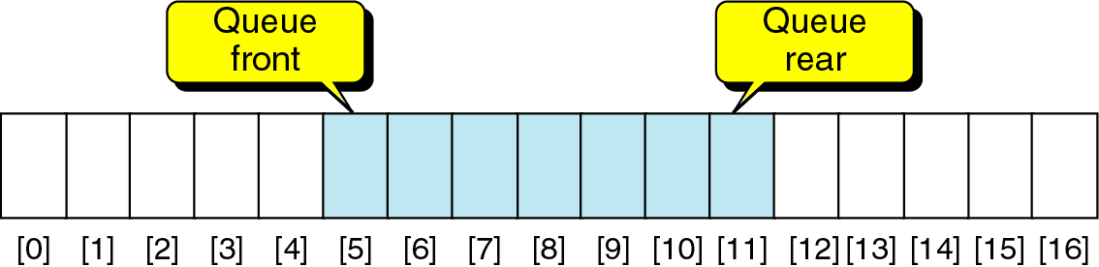
Circular Queue
Use Linear Array to implement a queue.
Waste of memory: The deleted elements can not be re-used.
Solution: to use circular queue.

Slide 26
Circular queue is a linear data structure. It follows FIFO principle.
In circular queue the last node is connected back to the first node to make a circle.
It is also called as “Ring buffer”.
Items can inserted and deleted from a queue in O(1) time.
X
X
X
X
R
F
X
X
X
X
X
X
X
X

Slide 27
Circular Queue: Enqueue operation
void insert() {
if((front==0 && rear==SIZE-1) || (front==rear+1))
printf("\n\nQueue is full.");
else {
printf("\n\nEnter ITEM: ");
scanf("%d", &item);
if(rear == -1) {
front = rear = 0; }
else if(rear == SIZE-1)
rear = 0;
else
rear++;
queue[rear] = item;
printf("\n\nItem inserted: %d\n", item);
} }

Slide 28
Circular Queue: dequeue operation
void delet() {
if(front == -1)
printf("\n\nQueue is empty.\n");
else {
item = queue[front];
if(front == rear) {
front = -1; rear = -1; }
else if(front == SIZE-1)
front = 0;
else
front++;
printf("\n\nITEM deleted: %d", item);
}
}

Slide 30
Applications of Queues
Direct applications:-
Waiting lists
Access to shared resources (e.g., printer)
Multiprogramming
Indirect applications:-
Auxiliary data structure for algorithms
Component of other data structures
‹#›
Lecture #00: © DSamanta
Notes:
‹#›

Slide 31
Priority queue
A priority queue is different from a "normal" queue, because instead of being a "first-in-first-out" data structure, values come out in order by priority.
An element of higher priority is processed before any element of lower priority.
Two element with same priority are processed according to the order in which they were added to queue.
A priority queue might be used, for example, to handle the jobs sent to the Computer Science Department's printer: Jobs sent by the department chair should be printed first, then jobs sent by professors, then those sent by graduate students, and finally those sent by undergraduates.

Slide 32
void insert(int data,int priority)
{
NODE *temp,*q;
temp = (NODE *)malloc(sizeof(NODE));
temp->info = data;
temp->priority = priority;
// condition to check whether the first element is empty or the element to be inserted has more priority than the first element
if( front == NULL || priority < front->priority )
{
temp->link = front;
front = temp;
}
else
{
q = front;
while( q->link != NULL && q->link->priority <= priority )
q=q->link;
temp->link = q->link;
q->link = temp;
}
}
typedef struct node
{
int priority;
int info;
struct node *link;
}NODE;
NODE *front = NULL;
void del()
{
NODE *temp;
// condition to check whether the Queue is empty or not
if(front == NULL)
printf("Queue Underflow\n");
else
{
temp = front;
printf("Deleted item is %d\n", temp->info);
front = front->link;
free(temp);
}

Slide 33
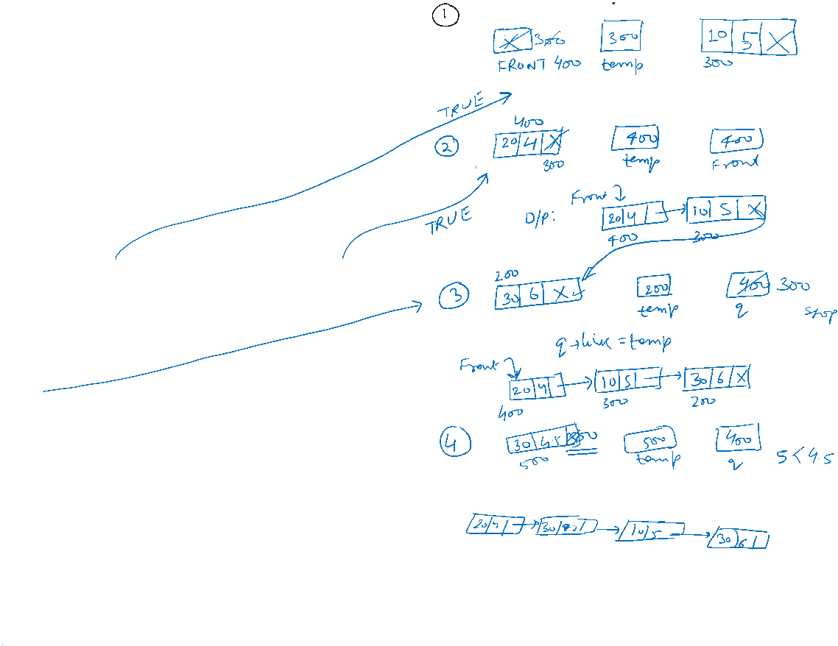
void insert(int data,int priority)
{
NODE *temp,*q;
temp = (NODE *)malloc(sizeof(NODE));
temp->info = data;
temp->priority = priority;
// condition to check whether the first element is empty or the element to be inserted has more priority than the first element
if( front == NULL || priority < front->priority )
{
temp->link = front;
front = temp;
}
else
{
q = front;
while( q->link != NULL && q->link->priority <= priority )
q=q->link;
temp->link = q->link;
q->link = temp;
}
}

Slide 34
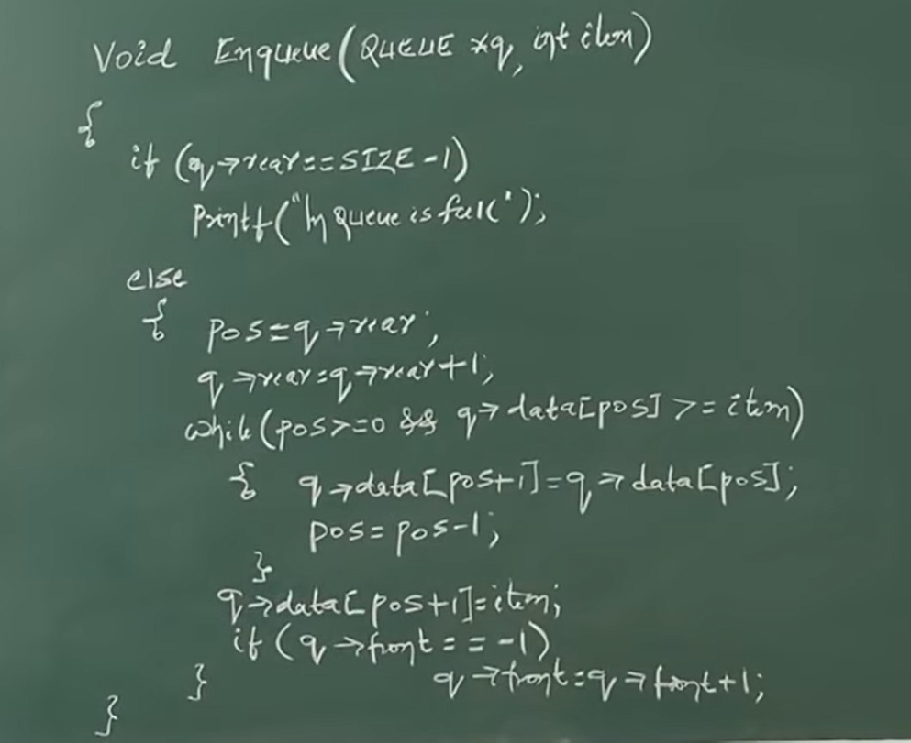
PQ using Array

Slide 35
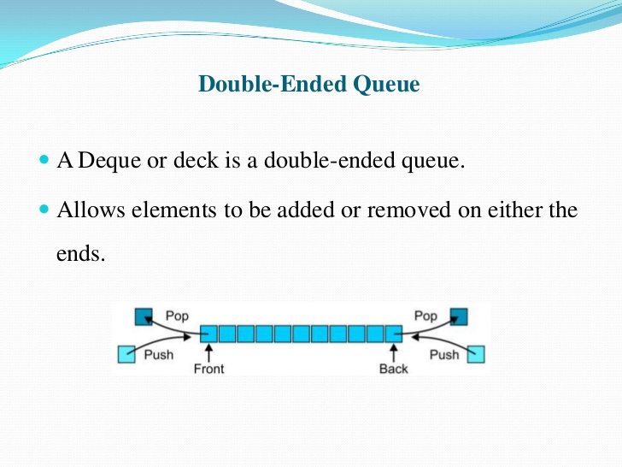

Slide 36
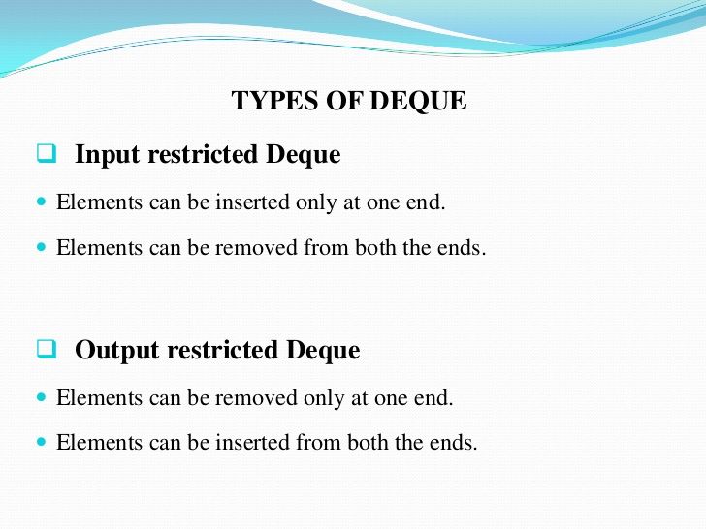

Slide 37
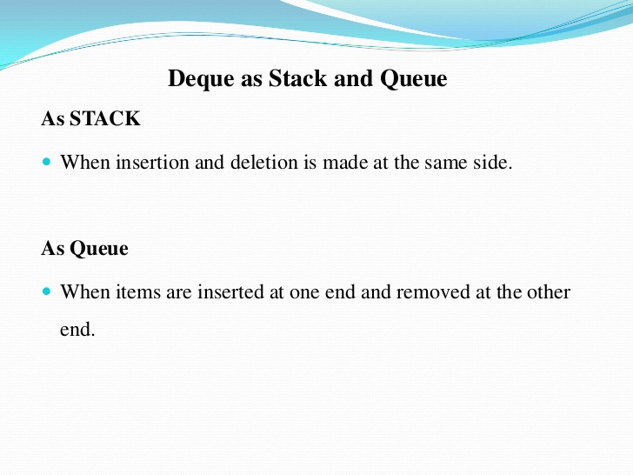

Slide 38
